Slide 1
ENERGATE Project Overview
16th International Conference on Information,
Intelligence, Systems and Applications
5th International Workshop on AI & Data Analytics in the Energy Sector
#SmartEnergyCluster Summit
Presenter: Eleni Stigka, Greenesco

Slide 2


The Challenge
Building side
VS
Financial side
Needs
Access to finance
Technical expertise
Interests
Barriers
High upfront costs
Lack of awareness and information
Simplified processes
Complexity of procedures
Energy and cost savings
Property value enhancement
Enhanced Comfort and Indoor Environment Quality
Needs
Interests
Investment Security
Barriers
Perceived Risks
Lack of Standardised Procedures
Sustainable Investment Opportunities
Portfolio Diversification
Reliable data on EE projects
Large financeable packages
Uncertain or weak economic environment
Project evaluation and risk assessment
Notes:
The building sector faces a dual challenge: advancing energy efficiency while overcoming financial barriers to retrofitting. Many projects struggle with fragmented information, limited access to finance, and high perceived risks. ENERGATE addresses these issues by providing a streamlined marketplace to match projects with the right investors.

Slide 3




The ENERGATE Project
The ENERGATE vision
Enable easy, predictable and risk-weighted renovation investments
https://energate.epu.ntua.gr/
Project development of retrofitting actions
Access to sustainable finance for renovation projects
January 2023 – December 2025
Business matchmaking in a user-friendly ICT-enabled platform
Notes:
ENERGATE envisions a future where energy renovation investments are easy, predictable, and low-risk. Our platform consolidates technical and financial data, supports project bundling, and facilitates business matchmaking, creating a seamless ecosystem for scaling sustainable renovations.

Slide 4
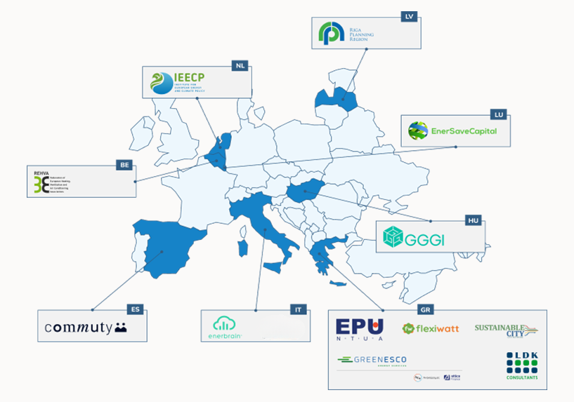

The ENERGATE Consortium
Well-balanced in terms of company types, expertise and value chain.
Complementary expertise, from research and industry area:
  Research
  Public sector
  Consultants
  ESCO
  Asset managers
  IoT, cloud-based service providers
  International organization
  HVDC Associations
Deliver successful exploitation of project results
Project Coordinator
Notes:
Our consortium brings together a diverse network of experts across research, public sectors, ESCOs, and financial institutions. This balanced mix ensures ENERGATE is well-equipped to address technical, economic, and operational challenges, driving real impact in the energy efficiency landscape.

Slide 5




ENERGATE user categories
Private owners, building administrators, building managers, asset managers, property managers, and real estate developers
Funds, investors, banks financing bodies, financial institutions
Use the platform to:
Use the platform to:
  Declare financial and non-financial criteria​ to be matched with projects
  See the projects ranked according to the declared criteria and preferences​
  Access information about the projects​
  Provide financial support
  Banks: promote their financial products
  Create profiles for your buildings
  Select energy efficiency measures to be applied
  Select preferred type of financing
  Search for renovation experts
Building owners
Financiers
Municipalities, cities, regions, communities, public procurement bodies
Project developers, ESCOs, architect & design companies, engineering companies, real estate companies with technical teams in-house
New!
Use the platform to:
Use the platform to:
  Announce energy efficiency projects to inform Implementors and Financiers about upcoming renovation needs
  Explore EU/national funding for public sector projects
  Notify users of needed support based on project stage and budget
  Match with Financiers for KPI-defined projects with assigned Implementors
  Directly engage Implementors for small-scale, non-tendered projects
  Insert buildings or be matched with buildings that need renovation​​
  Extract well-structured offers with project details​
  Aggregate projects
  Find financial support
Implementors
Public
bodies

Slide 6

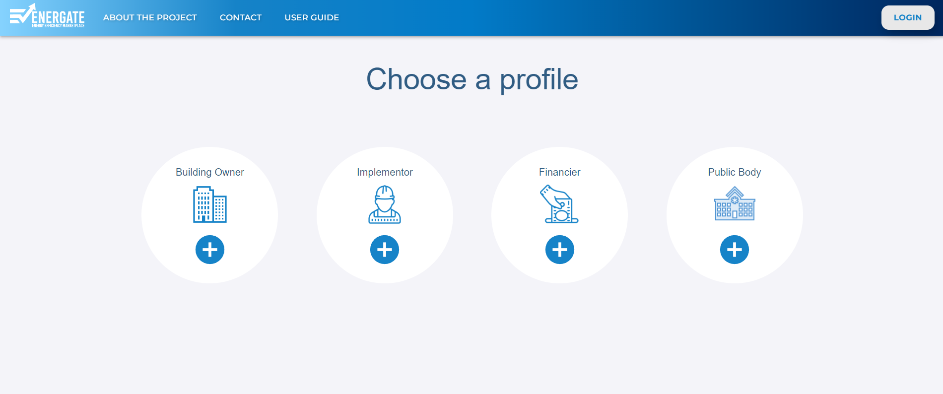
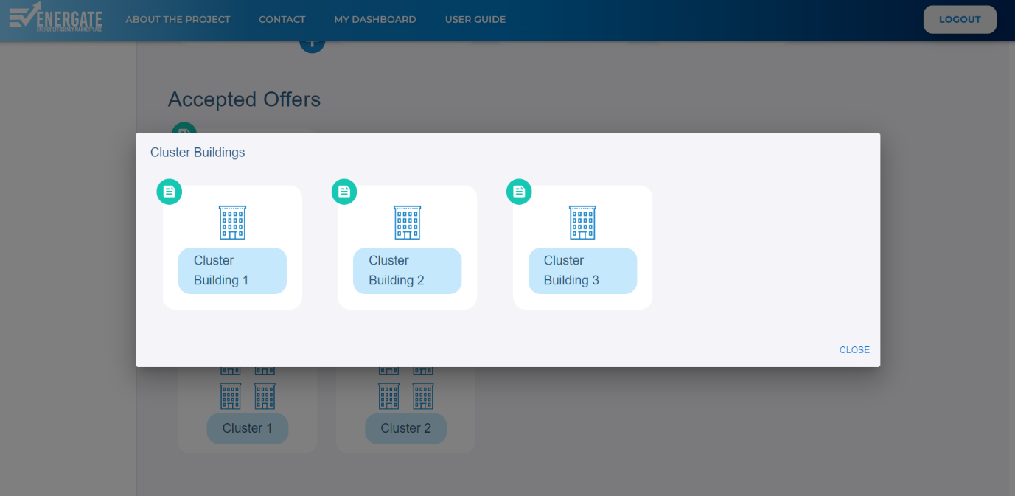
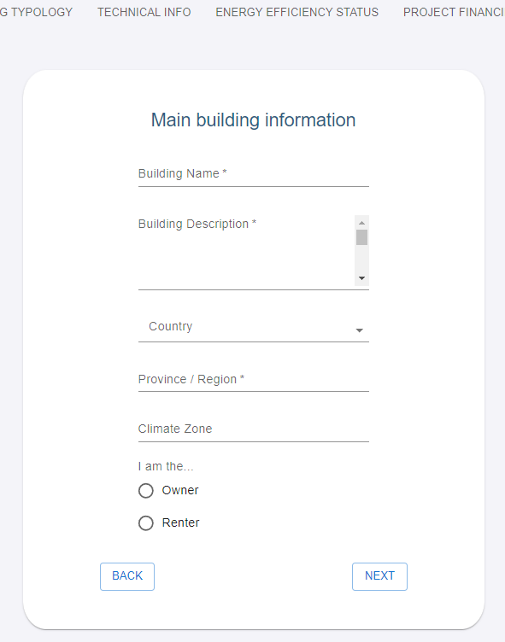
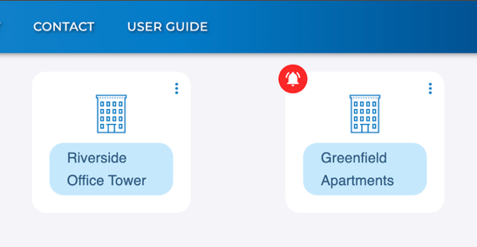
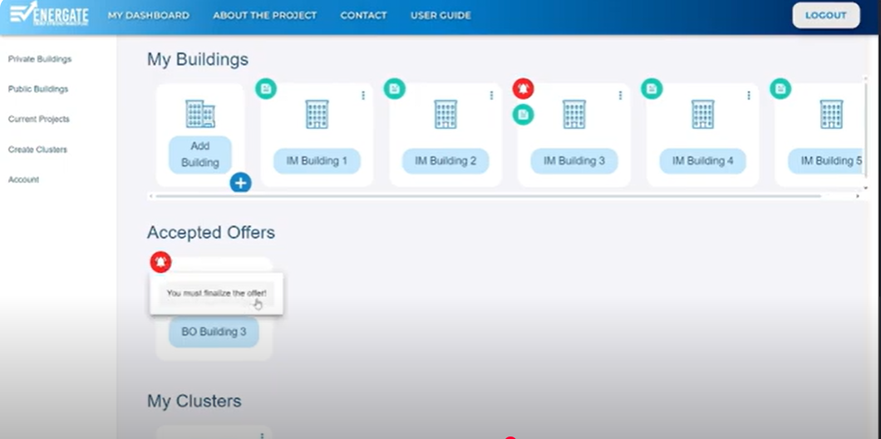
ENERGATE Services (1/2)
Marketplace UI

Slide 7
ENERGATE Services (2/2)
Matching buildings with Implementors
Matchmaking between projects and Financiers
Aggregation of projects
Supporting Public Bodies in searching for finance
Decision support based on data from previous projects
Monitoring user performance
Risk assessment
Calculating economic indicators
Monitoring project results

Slide 8
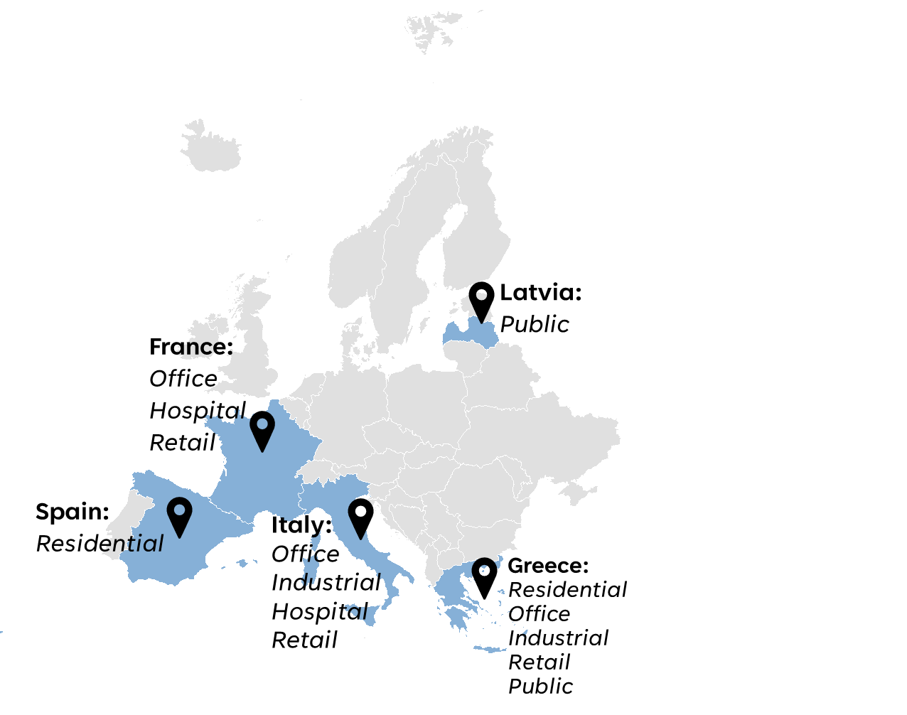
ENERGATE Pilots
Registered projects per country
Registered projects per building typology
Notes:
No building yet in Austria, however Enerbrain explores this and has identified building case in Germany as well.

Slide 9
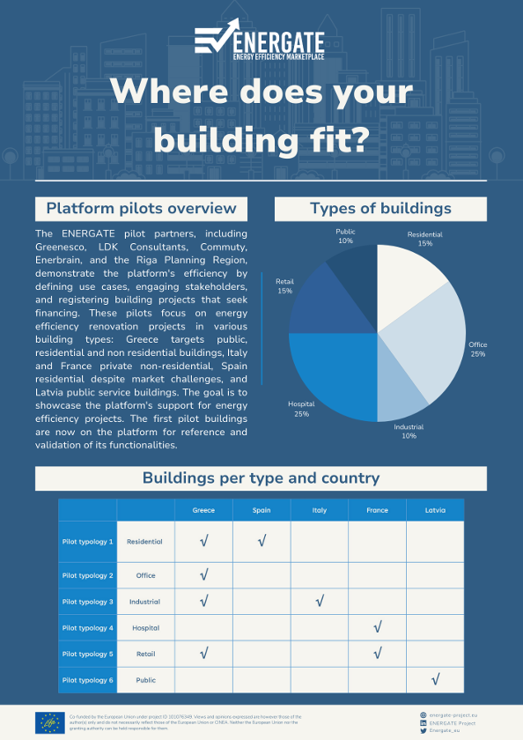
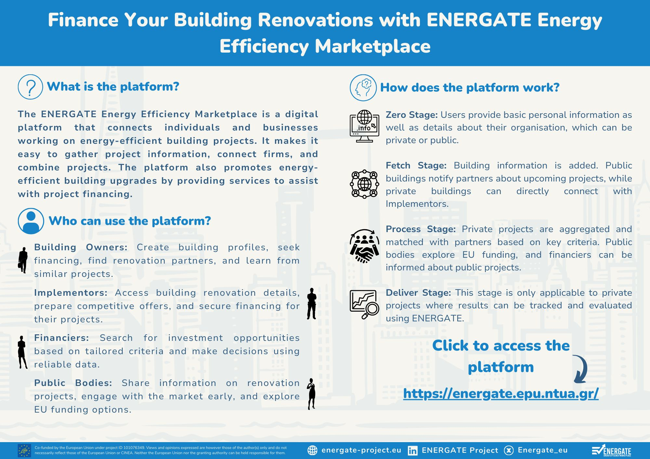
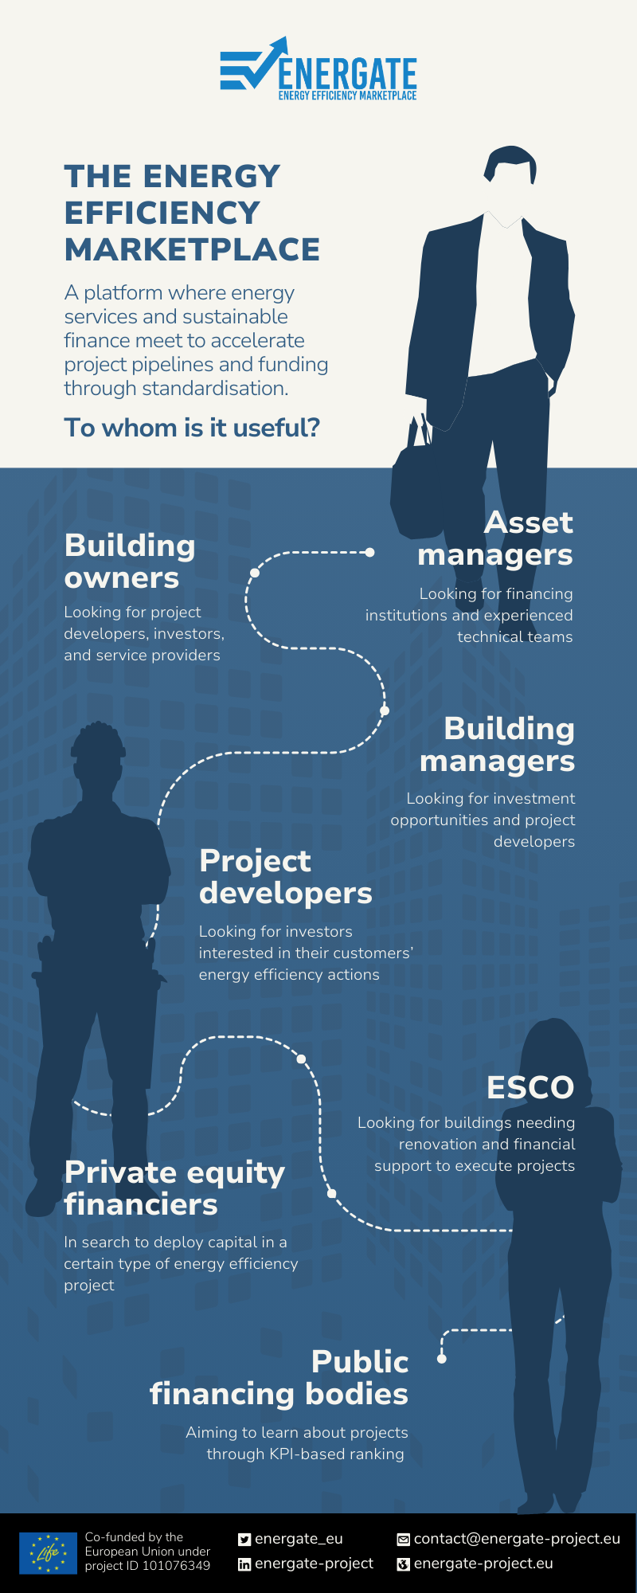
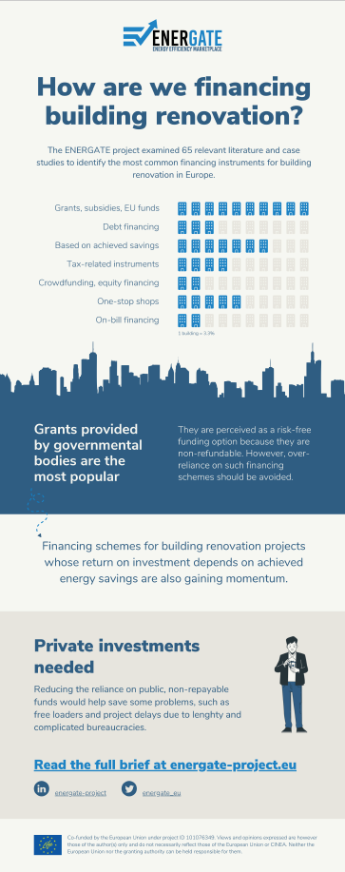


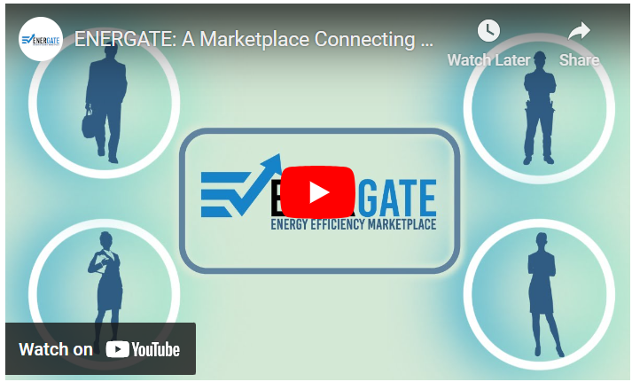
Explore our Results
What is the ENERGATE Platform?
ENERGATE Infographic on Planning the Main Pilot Typologies
Discover ENERGATE - Your Energy Efficiency Aggregation Marketplace
ENERGATE Use Cases
ENERGATE Factsheet on Financing Typologies for Building Renovation
ENERGATE Video

Slide 10
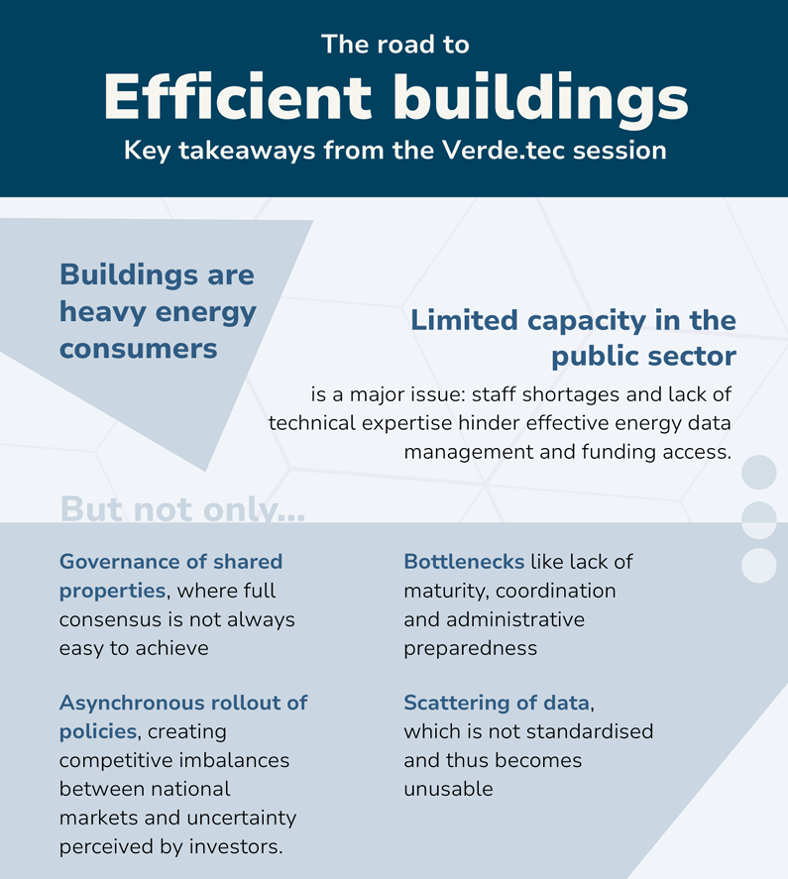
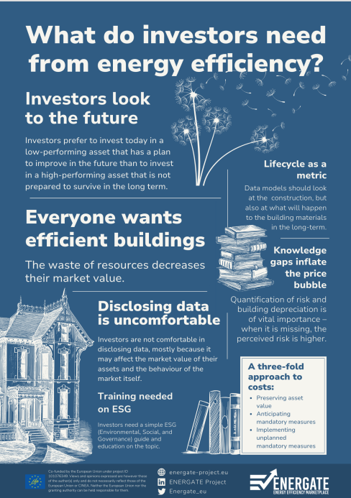
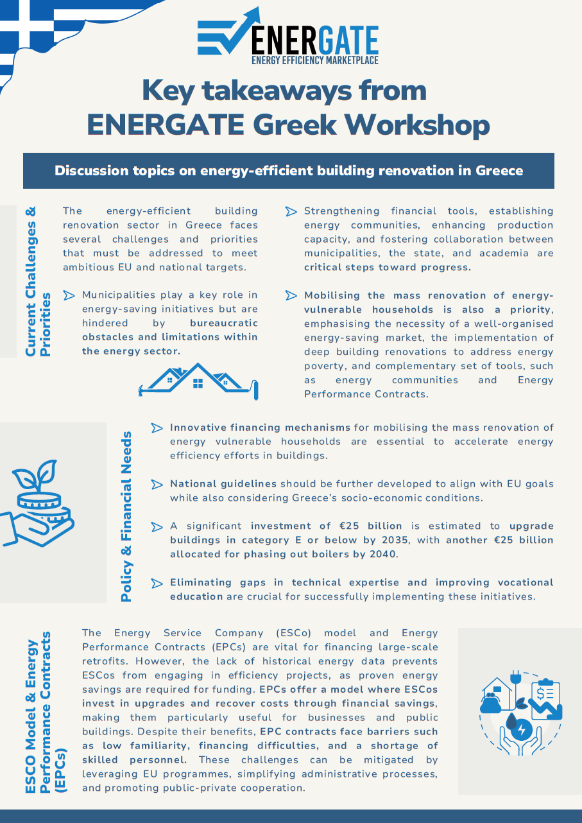
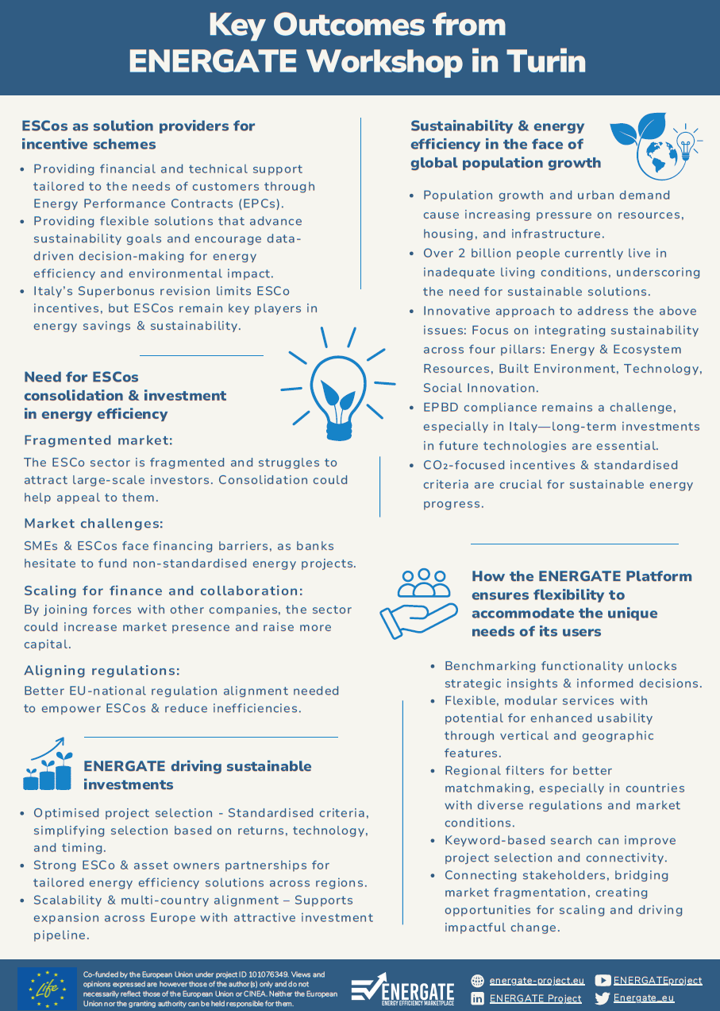
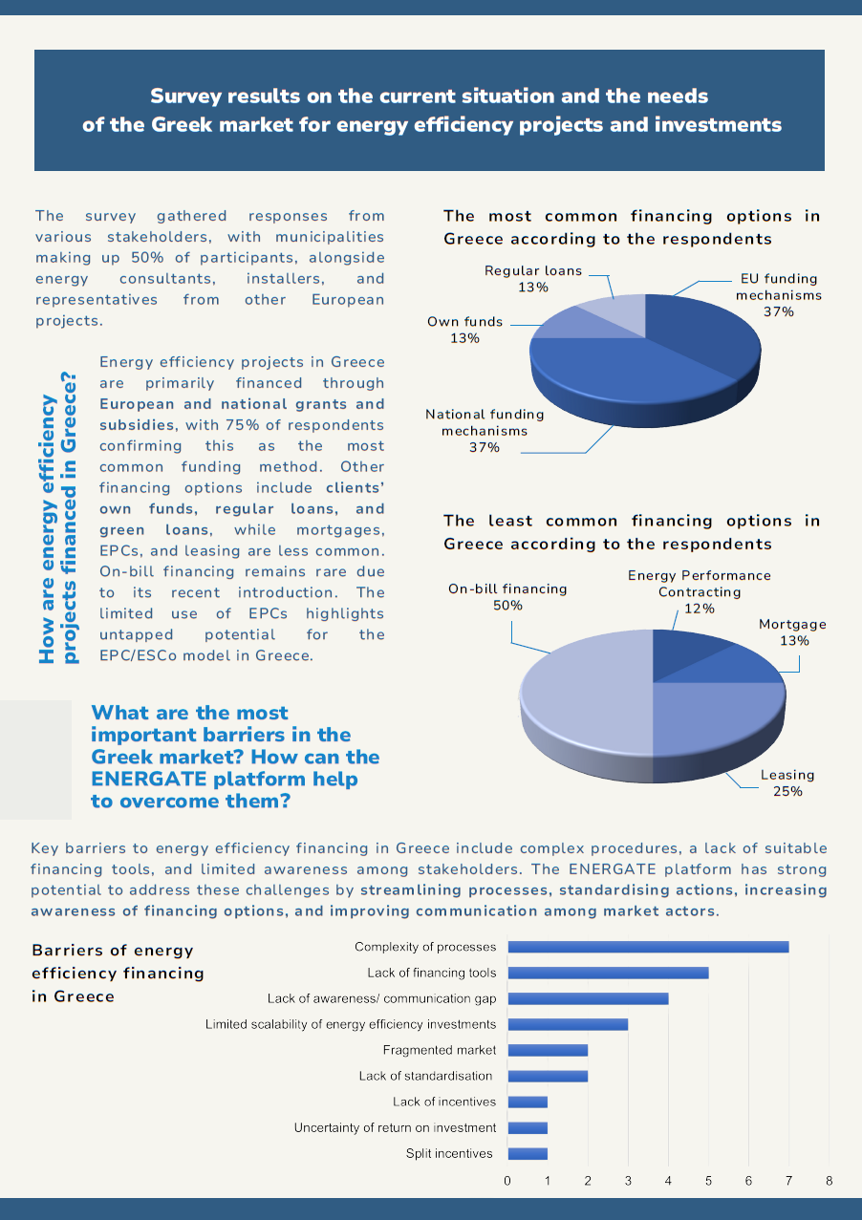
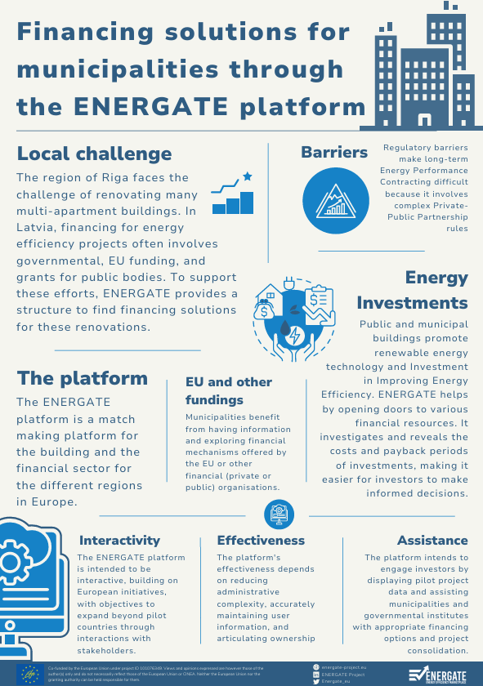

Explore our Results
Factsheet on ENERGATE Verde.tec International Exhibition Workshop
Factsheet on ENERGATE Regional Training Workshop in Madrid
Factsheet on ENERGATE National Workshop in Greece
Factsheet on ENERGATE 3rd Regional Training Workshop in Turin
Factsheet on ENERGATE 2nd Regional Training Workshop in Riga
ENERGATE Brief on 2nd Regional Training Workshop in Riga

Slide 11
Eleni Stigka, Greenesco

